Slide 1
Activity report 2017
Persevering on our journey
from good to great

Slide 2
Some key figures- from 2016 to 2017
Less advocacy meetings (143 to 60); increase of member organisations (+22 from 8); increase of speaking roles (100+ from 91)

Slide 3
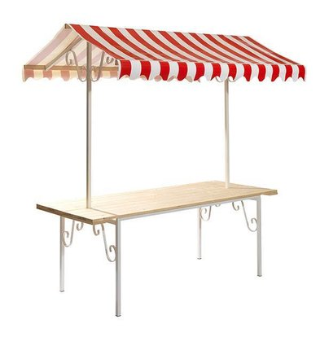
Migration
183.000€
Advocacy
Same rights for all migrants; successful amendments Blue Card Directive; EPAM; REIS
SR on Migration
Innovative survey on racial discrimination faced by newly arrived migrants (5000+) (66 media quotes)
Impact: visibilisation of racism in migration policies; enhanced protection for highly skilled migrants

Slide 4
AR community mobilisation
68.000€
14 national projects across EU
(migration, hate crime, Afrophobia, Islamophobia, EDC)
40 members trained on funding schemes and advocacy
Impact: 40% of members engaged in advocacy at EU & nat. levels; improved applications for ENAR and for EC

Slide 5
Equal@work – Brussels White Out
41.000€
T-Kit on refugee integration at
workplace (UNHCR endorsed)
T-Kit on managing religion at workplace
Seminar on Women of Colour (T-kit to come)
Coca-Cola (17) and Inditex (18) joining
#BrusselsSoWhite media splash
Impact: intersectionality, visibilisation of WoC in D&I, awareness of lack of diversity in EU institutions

Slide 6
Forms of racism
75.000€
Antisemitism: roadmap for MS;
No hate speech mov; coalition building;
Antigypsyism: SG; Alliance; advocacy on structural AG; Partner EP Roma week; book on AG with Zentralrat Sinti & Roma;
Impact: AG recognized as structural form of racism by EC/EP

Slide 7
Forms of racism 2
Islamophobia: European coalition; VP Timmermans statement on 21/09; UN high level forum; training of 30 CoE advisers on Muslim women & Islamophobia; Debunking myth on Muslim women and feminism
Afrophobia: delegation to regional meeting UNDPAD; 15 high-level advocacy meetings; EP LIBE meeting; publication of CoE Commissioner for HR; SG; US CBC;
Impact: high level recognition of Islamophobia and Afrophobia by EC; 124 times in media;

Slide 8
Other projects – NDI – DARE
71.000€
Facilitating networking with
CSOs in Visegrad countries with NDI
60 CS activist trained on advocacy and community organizing;
Impact: Increased membership of ENAR; empowered CSOs
DARE: develop T-kit in collaboration with PcF; advocacy (Policy brief); final conference 2021; host research in BE; dare-h2020.org
Impact: Increased understanding of resilience of youth faced to radicalization; link with social factors

Slide 9
Security and CT
48.000€
Advocacy EC, EP TERR, Council
on HR and AD concerns
T-Kit to monitor document racial & religious discrimination in CT, CR (roll out 2018)
Advocacy w. OSJI on ethnic profiling
DARE
Impact: FRA reviews handbook on Ethnic profiling; ND provisions in reporting obligations of MS to EC on CTD

Slide 10
NAPAR
20.000€
Research to benchmark the
development of good NAPAR;
Advocacy at EC & national level
Building interest among AR CSOs
Impact: increased political will (BE, DE, SK, SW, PT)

Slide 11
And more…
Equality Data Collection
(EC handbook, 3 national projects => EC recommendations)
Tackling racist crime & speech
(Facing Facts; advocacy for sanctions in EP; advocacy on EC hate crime training => improved EU standards)
Intersectional approach to AR
CS steering committee of EC HLG RX
HRDN, SDG-Watch, “the Europe we want”
Fundraising session Board/Staff; Board; SFSC, GA; Staff development; Board-Staff training…

